Slide 1



US Bank Failures - A 25-Year Historical Analysis (2000 - 2025)
Suman Duduka
View in Power BI

Slide 2

Project Objective
To analyze 25 years of volatility in the US banking sector, identifying key trends, crisis points, and providing actionable historical insights through an automated BI solution.
Pre-2008 Financial Crisis
Using advanced bookmarking, users can instantly toggle the dashboard to filter for data strictly before the 2008 financial crash, isolating early warning signs.
Post-2008 Financial Crisis
A second mode switches the entire dashboard context to the post-crisis era, highlighting the recovery period and recent volatility in the 2020s.

Slide 3

Realtime Analysis with Live Web Connection
Real-Time FDIC Connection
This reporting solution bypasses static CSV flat files (Import Mode) by establishing a direct, live connection (Direct Query Mode) to the FDIC government database.

Slide 4
Advanced Time Intelligence
Drill-Down Capabilities
A robust Star Schema with a custom Date Table allows for precise time-based analysis across quarter, year, and decade.
The "Play Axis"
I integrated the Play Axis visual to automate the storytelling experience, allowing stakeholders to watch the yearly trends animate and evolve from 2000 to the present day.

Slide 5


Microsoft Power BI – Interactive Report (Click on visuals to change

Slide 6
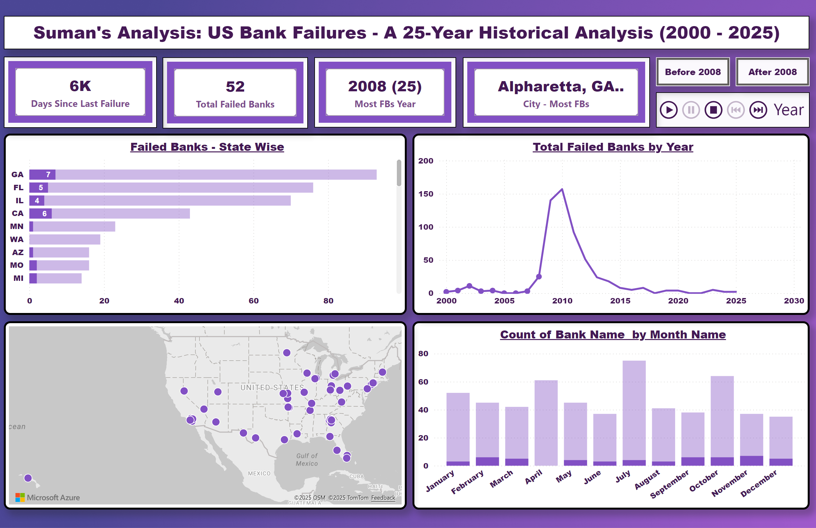
Main Report
Pre-2008 Crisis Mode

Slide 7
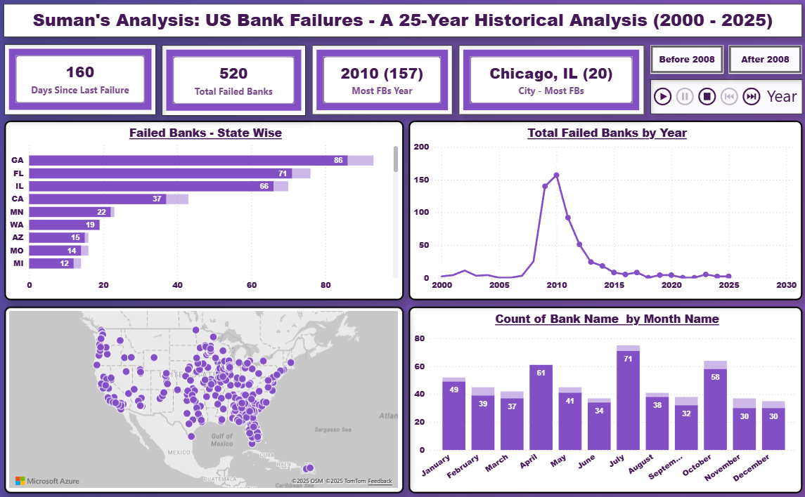
Main Report
Post-2008 Financial Crisis

Slide 8
The Peak Year – Most FBs
157
The Year 2010
My report uncovered that 2010 was the single most volatile year in the last quarter-century, representing the aftershock of the 2008 financial crisis.
BANK FAILURES

Slide 9
The COVID Years
9
2020 - 2023
COVID Years was not as bad as 2008 Financial Crisis. This shows us how prepared institutions were for such major concerning global events. 2021 and 2022 had 0 failures.
BANK FAILURES

Slide 10
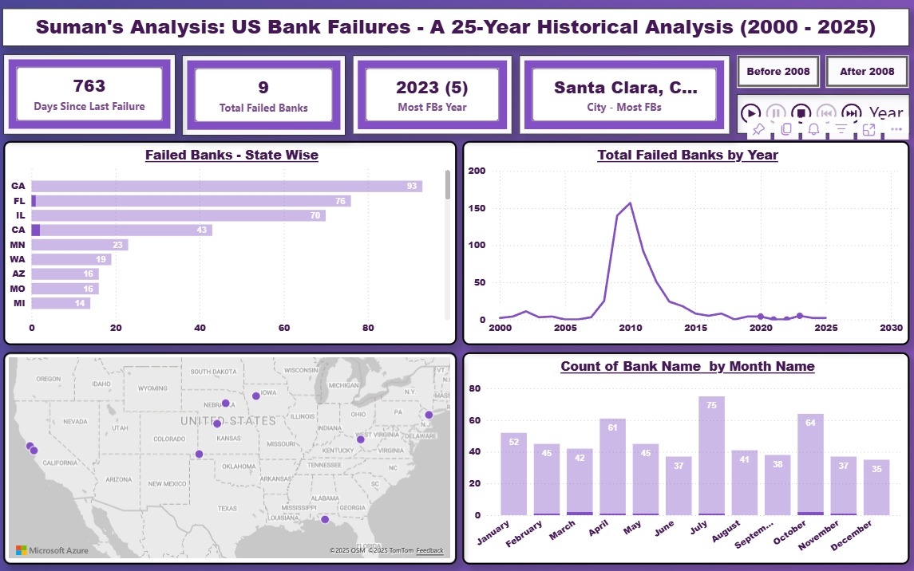
Main Report
COVID Years (2020 – 2023)

Slide 11
Thank You
Explore the interactive report on my portfolio.

